Slide 1



Phonics screening check
Presentation to parents and carers
May 2026

Slide 2
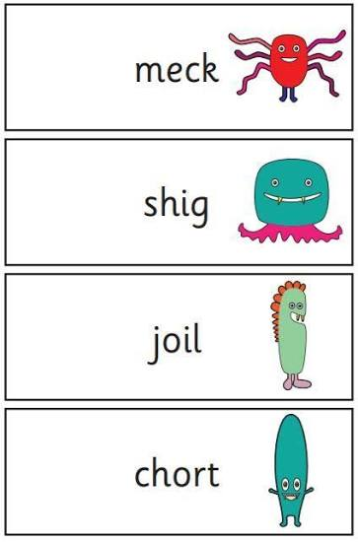
In Key Stage 1, the children are assessed at the end of Year 1 using a Government Statutory Assessment Tool known as the Phonics Screening Check.
This screening check confirms whether your child has learned phonic decoding to an appropriate standard and will identify sounds needing further consolidation in Year 2.
The children will complete the check individually with Mrs Barker, our Phonics leader, who knows the children very well.
The children have already completed checks with Mrs Barker earlier in the year so this is a very familiar process for the children.

Slide 3

The children are asked to read a mixture of real and alien nonsense words.

Slide 4
The ‘alien’ words are always presented with a picture of an alien, so that the children know that they are not real words that they might recognise. They are very familiar with this concept and we practise regularly as a class together.

Slide 5
Each child is taken through the screening check with Mrs Barker on a one to one basis. This will be in a quiet area and there is not a time limit.
The results of the check will be issued before the end of the school year.
The standard threshold pass mark for previous phonics screening checks has been 32/40. The threshold is always released shortly after the phonics screening check has taken place.

Slide 6
Any child that does not reach the standard threshold will sit the next screening check when they are in year 2, with the following year’s cohort of year 1s.
The government requires that the check must be taken during a specific week in June.
In 2026, the check will take place during the week beginning 8th June.
A pupil may only take the check the following week if they were absent during check week. If a pupil doesn’t take the check during this period and returns to school after the two week window, they must be recorded as absent.

Slide 7

We make sure that all children are happy and settled and that they have a very positive experience.

Slide 8

Thank you for your support.

